Slide 1
Gold standard of evidence: Randomized Control Trial 101
Thuy Nguyen

Slide 2
What is the health effect of exercising?
Independent variable:
Dependent variable:

Slide 3
What is the health effect of exercising?
Independent variable: whether someone exercises or not
Dependent variable:

Slide 4
What is the health effect of exercising?
Independent variable: whether someone exercises or not
Dependent variable: cholesterol levels
How much time per week does someone spend exercising?
Blood pressure? Resting heart rate? Mobility?
Many ways to define
the independent and dependent variables!

Slide 5
What is the health effect of exercising?
Gather data

Slide 6
What is the health effect of exercising?
Ask whether someone exercises
Person does not exercise
Person exercises

Slide 7
What is the health effect of exercising?
Cholesterol levels
Exercising raises cholesterol levels???
Person does not exercise
Person exercises
Exercise
Don’t exercise
Notes:
What is the graph showing?
Does exercising raise cholesterol levels? Why might we be seeing such contradictory results? (Hint: bias)

Slide 8
Bias: systematic error in sampling or testing
Exercising raises cholesterol levels???
Cholesterol levels
A potential bias
Individuals who are unhealthy or have health issues may be more motivated to exercise
Exercise
Don’t exercise
Notes:
What is the graph showing?
Does exercising raise cholesterol levels? Why might we be seeing such contradictory results? (Hint: bias)

Slide 9
Solution: Fair Experiment
How would you design a fair experiment?
Treatment: Daily cardio exercises for 30 mins
Control: Light stretching exercises for 30 mins
Why might we want to provide the control group with light stretching exercises?

Slide 10
Randomized Control Trial

Slide 11
Randomized Control Trial
Before Treatment
Cholesterol levels
If the randomization is done correctly, baseline cholesterol levels should be similar before treatment
Control/Baseline group
Treatment/Experimental group
Control group
Treatment group

Slide 12
Treatment Effect: Daily Exercise
After Treatment
Cholesterol levels
Control/Baseline group
Treatment/Experimental group
Control group
Treatment group

Slide 13
Takeaways
Bias could produce misleading and counterintuitive findings
Randomization at the start of the study ensures group comparability, allowing for a fair comparison
Defining the independent and dependent variables are at the heart of study design
Many considerations (e.g., ethical concerns, cognitive biases, and others) come into play when determining what the treatment and control groups receive

Slide 14
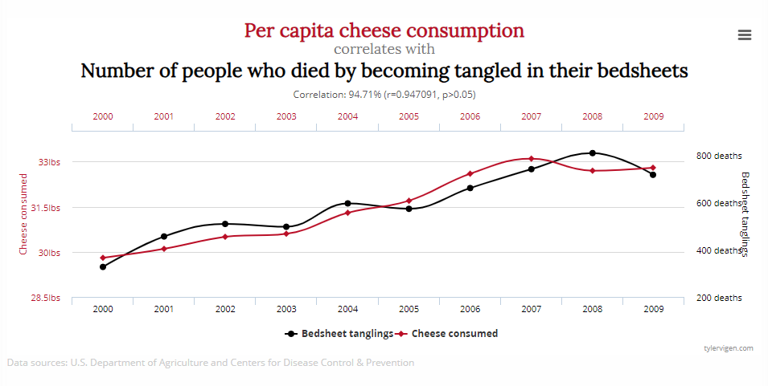
Spurious correlation
https://web.archive.org/web/20150514142734/http://tylervigen.com/spurious-correlations

Slide 15
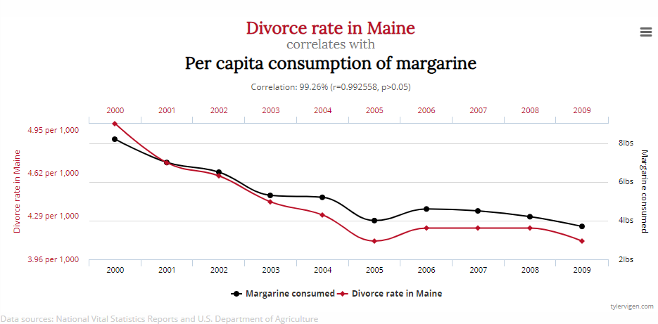
Spurious correlation
https://web.archive.org/web/20150514142734/http://tylervigen.com/spurious-correlations

Slide 16
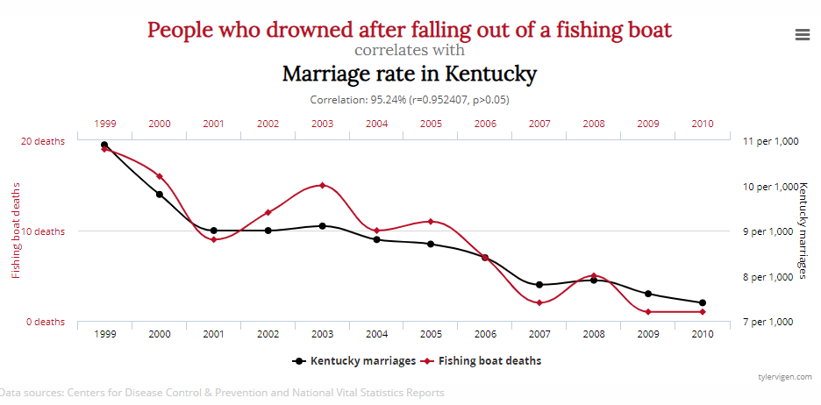
Spurious correlation
https://web.archive.org/web/20150514142734/http://tylervigen.com/spurious-correlations

